Slide 1
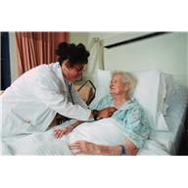
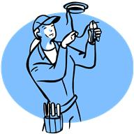
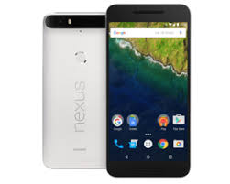
PROJECT VISHRAM is an Aggregator of Service Providers for the Elderly accessed through Relationship Managers (RMs)
RMs are needed since the Elderly may not be familiar with Smartphones or Apps. RMs understands the need and meets it through Apps/Tel Nos of Service Providers (SPs).
RMs could be persons with disability or housewives or Elderly
working from home.
Notes:
Innovation - The concept of providing multiple services by a single Point of Contact for Elders with Relationship Managers (RMs) is used in ‘Project Vishram’. Generally the services provided by various service providers are specific services like - medical care or grocery delivery etc. In Vishram the same RM facilitates different services. This model would integrate and empower persons with disability, housewives, retired service personal, etc. to be RMs all working from home.

Slide 2
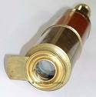
What is it?
Project Vishram is a Cost Effective Assisted Living option.
Not for Emergency Services & Not a substitute for
Old Age Homes / Geriatric Wards of Hospitals.
Multiple RMs of the locality could be reached with GPS (like Uber/Ola) by a touch of the screen by the Elder or Care Giver.
Any of the available RMs are assigned automatically or manually to attend to the Elder’s need. The RM would link to any of the multiple Service Providers (SPs).
Notes:
Examples of Services rendered: Some of the Elders have been rushed to the Hospital, some forms submitted, some Life Certificate for pensioners, IT Return being prepared and submitted, etc. Emergency Services are not being offered though RMs would provide assistance since we do not have any control of critical components like Ambulances and Drs on Call.

Slide 3
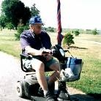
WHY THE NEED ?
Elderly:
Cherish independence & dislike isolation in Old Age Homes
Wish to manage own affairs Integrated in society. A cost effective option in familiar surroundings.
Family members away: Happy that
loved ones gets assistance.
Care Givers &Others: Access to
services (Medical & non Medical)
monitored by RMs.
Notes:
Impact - Presently, the Vishrm project has been rolled out in a limited region in & around Jal Vayu Vihar, Bangalore. At present it is a free service by volunteers.

Slide 4
HOW IT WORKS?
Project Vishram is an App for Relationship Managers (RMs) & an Aggregator of Apps and Tele Nos of Service Providers.
EUs need to touch the Vishram icon on the phone screen. Multiple RMs of the locality (like Uber/Ola) come to know of a need. Any of the RMs working from
home can choose to attend.
The RM give a ring to EU and understands the
Need. The RM checks member’s account
balance on the screen & contacts the appropriate App or Tele No of Service Providers (SPs), makes payments through App & monitor till the Need is met.
The App for RM would be ‘Lean’ and supported by a database
maintained on a backend site with all the records & transactions.
Notes:
Team - Stakeholders – Clients, RMs & Service Providers. There is no compulsion for RMs to take the call. So also a provision will be available to look for missed calls from EUs when RMs/Admin are available.

Slide 5
Uniqueness & Operations
Vishram is a concierge service with a human touch.
The uniqueness of Vishram is that Relationship Managers (RMs) working from home can be accessed with a touch on the screen for multiple services (Medical & Non Medical).
The affordable service charges are to meet the honorarium payable to Relationship Managers (RMs) and for overheads.
The target market are Elders and family members of the Elderly reached through Digital Marketing.
Vishram could also work as a CSR Model for Companies.

